Slide 1
CSS Image Gallery
By Brendan McCourt

Slide 2
What is it
A CSS Image Gallery is used to store and display collection of pictures.
In it’s most basic forms it displays an image with a small description underneath is.

Slide 3
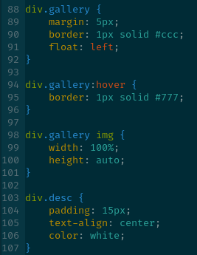
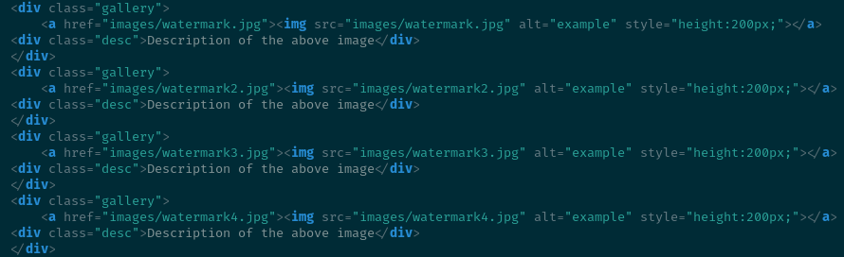
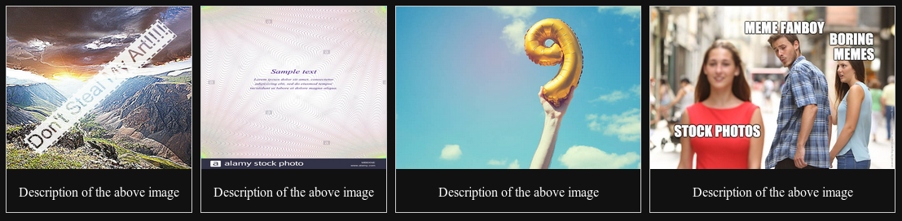
What it looks like

Slide 4
Why are they used
An example of why it would be used it for an artist to display there art and expand it when it’s clicked on, even being able to include a title on the image. This would be a “tabbed” image gallery.

Slide 5
“Tabbed” Image Gallery
A tabbed image gallery is a more advanced way of displaying an image. It puts an image or a group of images together in a small form, and when they are clicked on they expand. This of course requires javascript along with the CSS and HTML.

Slide 6
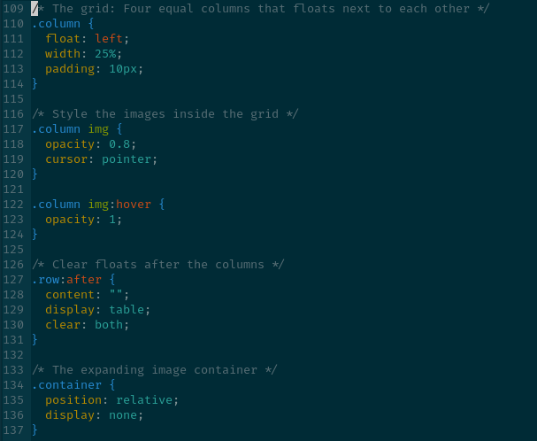
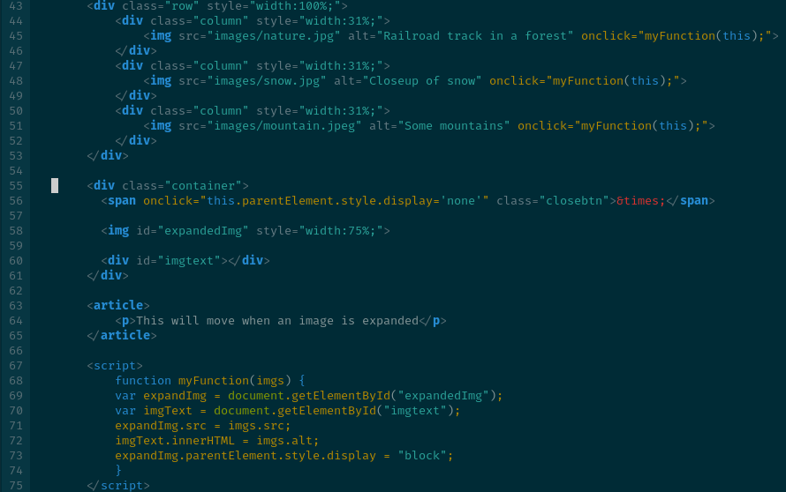
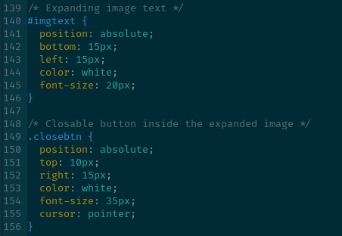
Example of “Tabbed” Image Gallery

Slide 7


The Result

Slide 8
Last Style
Another way image galleries are used is a slideshow. An image gallery will show all the images in a small form, with 1 of them being big and displayed for the user. It can change images automatically or manually based on what you want.

Slide 9
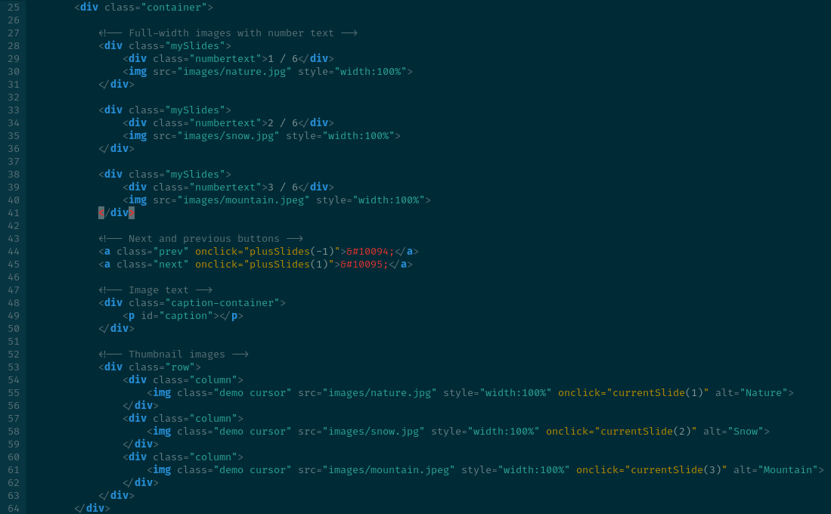
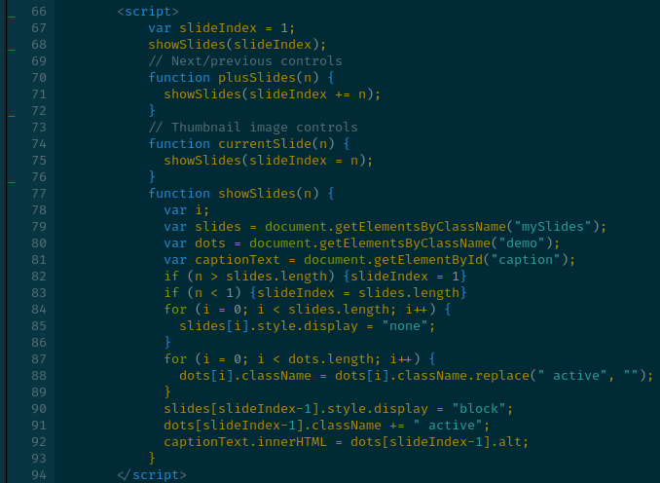
The Code

Slide 10
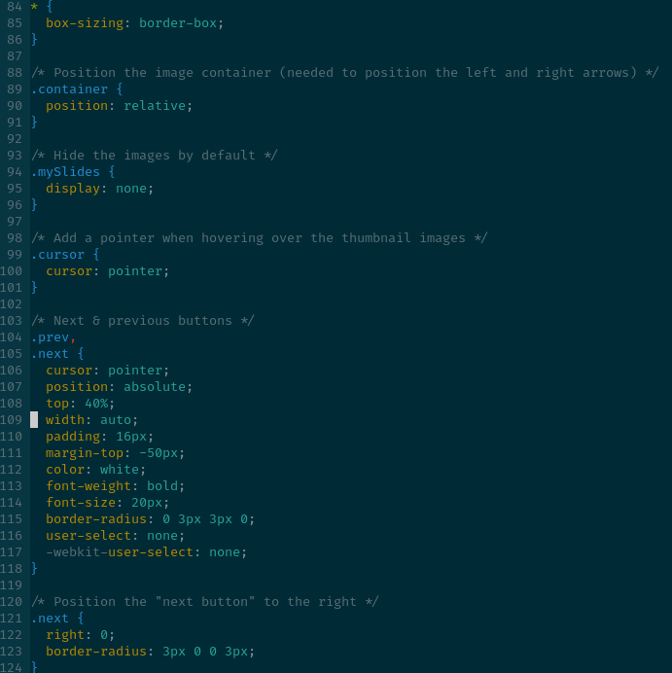
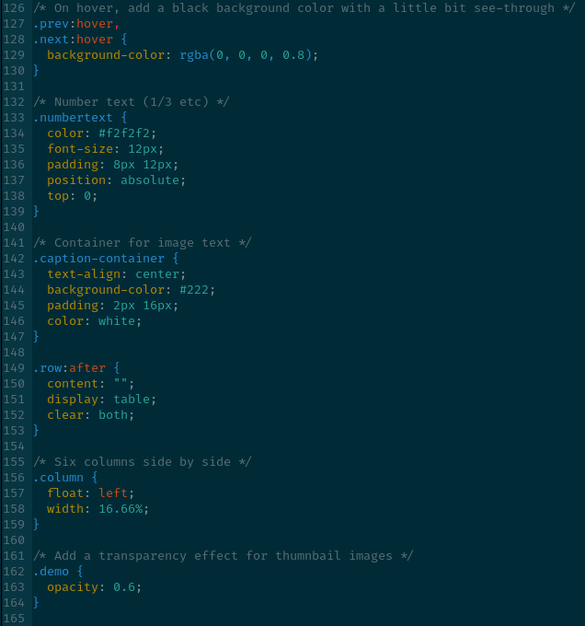

The Code 2

Slide 11
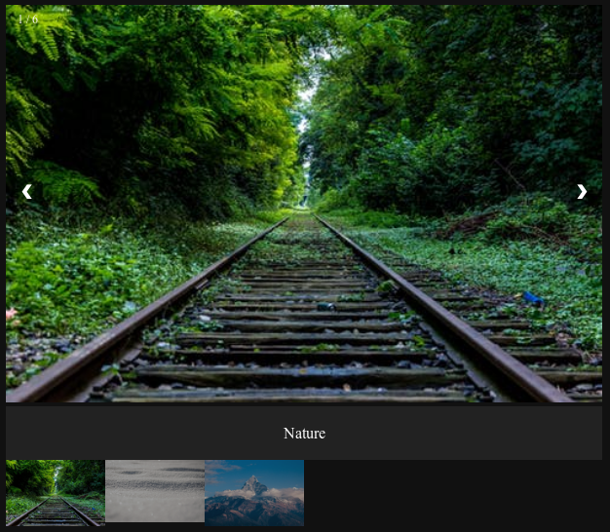
The Result

